Slide 1



2160707
Advanced Java
Unit-3 (Part-II)
Servlet API and Overview
Prof. Swati R. Sharma
swati.sharma@darshan.ac.in

Slide 2

Subject Overview
Sr. No. | Unit | % Weightage
1 | Java Networking | 5
2 | JDBC Programming | 10
3 | Servlet API and Overview | 25
4 | Java Server Pages | 25
5 | Java Server Faces | 10
6 | Hibernate | 15
7 | Java Web Frameworks: Spring MVC | 10
Reference Book:
Professional Java Server Programming by Subrahmanyam Allamaraju, Cedric Buest Wiley Publication
Chapter 6,7,8
ADVANCED JAVA - 2160707 Darshan Institute of Engineering & Technology

Slide 3
Cookies and Session Management

Slide 4
Session Management in Servlets
What is Session?
A session refers to the entire interaction between
a client and a server
from the time of the client’s first request,
which generally begins the session,
to the time of last request/response.
Notes:
The session could be terminated by the client’s request, or the server could automatically close it after a certain period of time.

Slide 5
Session Management in Servlets
Why we require Session?
HTTP is a "stateless" protocol which means each time a client retrieves a Web page, the client opens a separate connection to the Web server and the server automatically does not keep any record of previous client request.
Session is required to keep track of users and their information.
1. Request (New)
Client
Server
2. Response
3.Second Request (New)

Slide 6
Session Management
Example: Application of Session
When a User logs into your website, no matter on which web page he visits after logging in, his credentials will be with the server, until user logs out.
So this is managed by creating a session.

Slide 7
Session Management
Session Management is a mechanism used by the Web container to store session information for a particular user.
There are four different techniques for session management.
Hidden form field
URL Rewriting
Session Management
Cookies
HttpSession

Slide 8
Session Management: Hidden form field
Hidden Form Field, a hidden (invisible) textfield is used for maintaining the state of an user.
In such case, we store the information in the hidden field and get it from another servlet.
Example
<input type="hidden"
name="session_id"
value="054">

Slide 9
Session Management: Hidden form field
login.html
Valid.java
Name:
Password:
Session_ID:
request.getParameter(“name”);
request.getParameter(“password”);
request.getParameter(“session”);
Hidden Field
`
054
Submit
Welcome.java
request.getParameter(“session”);

Slide 10
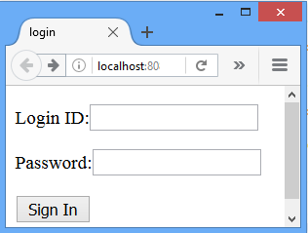
Session Management: Hidden form field
login.html
<html>
<head>
<title>login</title>
</head>
<body>
<form action="/Session/Valid" method="POST">
<p>Login ID:<input type="text" name="login"></p>
<p>Password:<input type="text" name="pwd"></p>
<p><input type="hidden" name="session_id" value="054"></p>
<p><input type="submit" value="Sign In"></p>
</form>
</body>
</html>

Slide 11
Session Management: Hidden form field
Valid.java
public class Valid extends HttpServlet
{ public void doPost(HttpServletRequest request, HttpServletResponse response)
throws ServletException,IOException
{
response.setContentType("text/html");
PrintWriter out=response.getWriter();
RequestDispatcher rd;
String login=request.getParameter("login");
String pwd=request.getParameter("pwd");
String session=request.getParameter("session_id");
Hidden Field

Slide 12
Session Management: Hidden form field
Valid.java
if(login.equals("java") && pwd.equals("servlet"))
{
rd=request.getRequestDispatcher("Welcome");
rd.forward(request, response);
}//if
else
{
out.println("<p><h1>Incorrect LoginId/Password </h1></p>");
rd=request.getRequestDispatcher("/login.html");
rd.include(request, response);
}//else
} }

Slide 13
Session Management: Hidden form field
Welcome.java
import javax.servlet.*;
import javax.servlet.http.*;
import java.io.*;
public class Welcome extends HttpServlet
{ public void doPost(HttpServletRequest request, HttpServletResponse response)
throws ServletException,IOException
{ response.setContentType("text/html");
PrintWriter out=response.getWriter();
String session=request.getParameter("session_id");
String username=request.getParameter("login");
out.println("<h1>"+"id:"+session+"</h1>");
out.println("<h3>"+"Welcome "+username+"</h3>");
}
}

Slide 14
Session Management: Hidden form field
Real application of hidden form field
It is widely used in comment form of a website.
In such case, we store page id or page name in the hidden field so that each page can be uniquely identified.

Slide 15
Session Management: Hidden form field
Advantage of Hidden Form Field
Easy to implement
It will always work whether cookie is disabled or not.

Slide 16
Session Management: Hidden form field
Disadvantage of Hidden Form Field:
It is maintained at server side.
Extra form submission is required on each pages.
Only textual information can be used.
It does not support hyperlink submission.
Security
Hidden field will be visible with GET method
User might view page source and can view hidden field

Slide 17
URL Rewriting

Slide 18
Session Management: URL Rewriting
In URL rewriting, a token or identifier is appended to the URL of the next Servlet or the next resource.
We can send parameter name/value pairs using the following format:
URL ? Name1 = value1 & name2 = value2 &…
When the user clicks the hyperlink, the parameter name/value pairs will be passed to the server.
From a Servlet, we can use getParameter() method to obtain a parameter value.
A name and a value is separated using an equal (=) sign
name/value pair is separated from another parameter using the ampersand(&)

Slide 19
Session Management: URL Rewriting
Url1.java
import javax.servlet.*;
import javax.servlet.http.*;
import java.io.*;
public class Url1 extends HttpServlet
{ public void doGet(HttpServletRequest request, HttpServletResponse response)
throws ServletException,IOException
{ String url;
response.setContentType("text/html");
PrintWriter out=response.getWriter();
//for URL rewriting
url= "http://localhost:8080/Session /Url2?s_id1=054&s_id2=055";
out.println("<a href="+url+">next page</a>");
} }
URL Rewriting

Slide 20
Session Management: URL Rewriting
Url2.java
import javax.servlet.*;
import javax.servlet.http.*;
import java.io.*;
public class Url2 extends HttpServlet
{ public void doGet(HttpServletRequest request, HttpServletResponse response)
throws ServletException,IOException
{ response.setContentType("text/html");
PrintWriter out=response.getWriter();
String session1=request.getParameter("s_id1");
String session2=request.getParameter("s_id2");
out.println("<h3>"+"id:"+session1+"</h3>");
out.println("<h3>"+"id:"+session2+"</h3>");
}
}

Slide 21
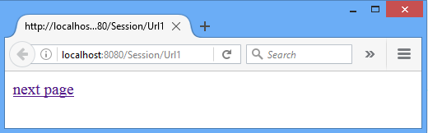
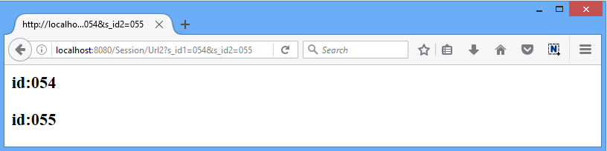
Session Management: URL Rewriting
Url1.java
Url2.java

Slide 22
Session Management: URL Rewriting
Advantage of URL Rewriting
It will always work whether cookie is disabled or not (browser independent).
Extra form submission is not required on each pages.
Disadvantage of URL Rewriting
It will work only with links.
It can send only textual information.
URL header size constraint.
Security
name/value field will be visible with URL followed by ‘?’.

Slide 23
Cookies
javax.servlet.http.Cookie

Slide 24
Session Management: Cookies
A cookie is a small piece of information that is persisted between the multiple client requests.
A cookie has a
Name
Single value
Optional attributes such as
comment
path
domain qualifiers
a maximum age
version number

Slide 25



Session Management: Cookies
By default, each request is considered as a new request
How Cookie works?
1. Request
Server will add cookie with response from the servlet
2. Response + Cookie
After that if request is sent by the user, cookie is added with request by default.
Thus, we recognize the user as the old user.
Web Client
So cookie is stored in the cache of the browser.
Server
3. Request + Cookie

Slide 26
Session Management: Cookies
Types of Cookie
Non-persistent cookie
Persistent cookie
It is valid for single session only.
It is removed each time when user closes the browser.
It is valid for multiple session .
It is not removed each time when user closes the browser.
It is removed only if user logout or signout.

Slide 27
Session Management: Cookies
Cookie class
javax.servlet.http.Cookie
This class provides the functionality of using cookies.
It provides a lots of useful methods for cookies.
Constructor
Example
Cookie c= new Cookie("session_id","054");
//creating cookie object
Cookie(String name, String value) | constructs a cookie with a specified name and value.

Slide 28
Session Management: Cookies
Methods of Cookie class
void setMaxAge(int expiry) | Sets the maximum age in seconds for this Cookie
int getMaxAge() | Gets the maximum age in seconds of this Cookie. By default, -1 is returned, which indicates that the cookie will persist until browser shutdown.
String getName() | Returns the name of the cookie. The name cannot be changed after creation.
void setValue (String newValue) | Assigns a new value to this Cookie.
String getValue() | Gets the current value of this Cookie.
Notes:
A positive value indicates that the cookie will expire after that many seconds have passed. Note that the value is the maximum age when the cookie will expire, not the cookie's current age.
A negative value means that the cookie is not stored persistently and will be deleted when the Web browser exits. A zero value causes the cookie to be deleted.

Slide 29
Session Management: Cookies
Other Methods of HttpServletRequest & HttpServletResponse
void addCookie(Cookie cookie) | Method of HttpServletResponse interface is used to add cookie in response object.
Cookie[] getCookies() | Returns an array containing all of the Cookie objects the client sent with this request. This method returns null if no cookies were sent.
Notes:
A positive value indicates that the cookie will expire after that many seconds have passed. Note that the value is the maximum age when the cookie will expire, not the cookie's current age.
A negative value means that the cookie is not stored persistently and will be deleted when the Web browser exits. A zero value causes the cookie to be deleted.

Slide 30
Session Management: Cookies
How to create Cookie?
Example
//creating cookie object
Cookie c= new Cookie("session_id","054");
//adding cookie in the response
response.addCookie(c);

Slide 31
Session Management: Cookies
How to retrieve Cookies?
Cookie c[]=request.getCookies();
for(int i=0;i<c.length;i++)
{
out.print(c[i].getName()+””+ c[i].getValue());
//printing name&value of cookie
}

Slide 32
Session Management: Cookies
How to delete Cookie?
Read an already existing cookie and store it in Cookie object.
Set cookie age as zero using setMaxAge() method to delete an existing cookie
Add this cookie back into response header.

Slide 33
Session Management: Cookies
How to delete Cookie?
//deleting value of cookie
Cookie c = new Cookie("user","");
//changing the maximum age to 0 seconds
c.setMaxAge(0);
//adding cookie in the response
response.addCookie(c);

Slide 34
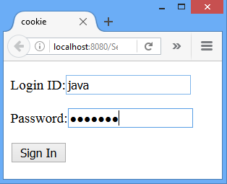
Session Management: Cookies
Cookie.html
Cookie1.java
Add Cookie
Cookie3.java
Retrieve All Cookies
Cookie2.java
Retrieve Cookie
Add Another Cookie

Slide 35
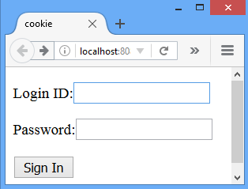
Session Management: Cookies
cookie.html
<html>
<head>
<title>cookie</title>
</head>
<body>
<form action="/Session/Cookie1" >
<p>Login ID:<input type="text" name="login"></p>
<p>Password:<input type="password" name="pwd"></p>
<p><input type="submit" value="Sign In"></p>
</form>
</body>
</html>

Slide 36
Session Management: Cookies
Cookie1.java
public class Cookie1 extends HttpServlet
{ public void doGet(HttpServletRequest request, HttpServletResponse response)
throws ServletException,IOException
{ response.setContentType("text/html");
PrintWriter out=response.getWriter();
String login=request.getParameter("login");
String pwd=request.getParameter("pwd");
if(login.equals("java") && pwd.equals("servlet"))
{ Cookie c = new Cookie("c1",login);//create cookie
response.addCookie(c);//adds cookie with response
out.println("Cookie named:"+c.getName()+" added");
String path="/Session/Cookie2";
out.println("<p><a href="+path+">next page</a></p>");
}
else { //Redirect page to cookie.html}
} }

Slide 37
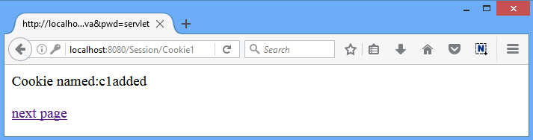
Session Management: Cookies
Output: Cookie1.java [add Cookie]

Slide 38
Session Management: Cookies
Cookie2.java
public class Cookie2 extends HttpServlet
{ public void doGet(HttpServletRequest request, HttpServletResponse response) throws ServletException,IOException
{ response.setContentType("text/html");
PrintWriter out=response.getWriter();
Cookie c[]=request.getCookies();
out.println("c.length="+c.length);
for(int i=0;i<c.length;i++)
{ out.println("CookieName="+c[i].getName()+
"CookieValue="+c[i].getValue());}
//to add another cookie
Cookie c1 = new Cookie("c2","054");
response.addCookie(c1);
String path="/Session/Cookie3";
out.println("<a href="+path+">next page</a>");}}

Slide 39
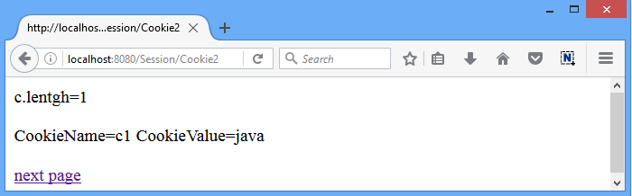
Session Management: Cookies
Output: Cookie1.java [Retrive Cookie and add one more cookie]

Slide 40
Session Management: Cookies
Cookie3.java
public class Cookie3 extends HttpServlet
{ public void doGet(HttpServletRequest request, HttpServletResponse response)
throws ServletException,IOException
{ response.setContentType("text/html");
PrintWriter out=response.getWriter();
Cookie c[]=request.getCookies();
for(int i=0;i<c.length;i++)
{ out.println("<p>");
out.println("CookieName="+c[i].getName()+
"CookieValue="+c[i].getValue());
out.println("</p>");
}
}
}

Slide 41
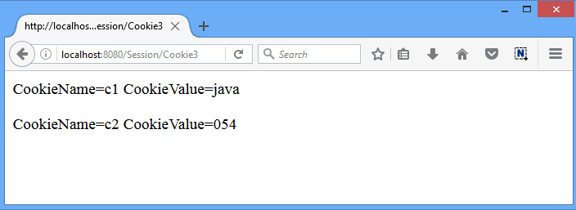
Session Management: Cookies
Output: Cookie1.java [Retrive all the Cookies]

Slide 42
Session Management: Cookies
Advantage of Cookies
Simplest technique of maintaining the state.
Cookies are maintained at client side.
Disadvantage of Cookies
It will not work if cookie is disabled from the browser.
Only textual information can be set in Cookie object.

Slide 43
Interview Questions: Cookies
1. | What Are Cookies?
2. | Can I see/view the cookies I have on my computer?
3. | What's in a Cookie? OR What does a Cookie contains?
4. | Why are Cookies Used?
5. | How Long Does a Cookie Last?
6. | How Secure are Cookies?
7. | What are Tracking Cookies?
8. | What do the Cookies Do?

Slide 44
Session Management
Session Management is a mechanism used by the Web container to store session information for a particular user.
There are four different techniques for session management.
Hidden form field
URL Rewriting
Session Management
Cookies
HttpSession

Slide 45
HttpSession
javax.servlet.http.HttpSession

Slide 46
Session Management: HttpSession
Apart from the above mentioned three ways, servlet provides HttpSession Interface which provides a way to identify a user across more than one page request
The container creates a session id for each user.
The container uses this id to identify the particular user.
An object of HttpSession can be used to perform two tasks:
Bind objects
View and manipulate information about a session, such as the session identifier, creation time, and last accessed time.

Slide 47
Session Management : HttpSession
Server
Web Container
Client1
Request
id=054
Session1
id= 054
Servlet
Session2
id= 055
Client2
Request
id=055
Working of HttpSession

Slide 48
Session Management :HttpSession
Package: javax.servlet.http.HttpSession
The servlet container uses this interface to create a session between an HTTP client and an HTTP server.
In this technique create a session object at server side for each client.
Session is available until the session time out, until the client log out.
The default session time is 30 minutes and can configure explicit session time in web.xml file.
Interface

Slide 49
Session Management : HttpSession
The HttpServletRequest interface provides two methods to get the object of HttpSession
HttpSession getSession() | Returns the current session associated with this request, or if the request does not have a session, creates one.
HttpSession getSession(boolean create) | Returns the current HttpSession associated with this request or, if there is no current session and create is true, returns a new session.

Slide 50
Session Management : HttpSession
Methods of HttpSession interface
String getId() | Returns a string containing the unique identifier value.
long getCreationTime() | Returns the time when this session was created, measured in milliseconds.
long getLastAccessedTime() | Returns the last time the client sent a request associated with this session, as the number of milliseconds.
void invalidate() | Invalidates this session then unbinds any objects bound to it.

Slide 51
Session Management : HttpSession
How to create the session?
HttpSession hs=request.getSession();
hs.setAttribute("s_id", "diet054");
How to retrieve a session?
HttpSession hs=request.getSession(false);
String n=(String)hs.getAttribute("s_id");
How to invalidate a session?
hs.invalidate();

Slide 52
Session Management : HttpSession
Httpsession.html
[Login page]
HSession1.java
[Create Session]
HSession2.java
[Retrieve Session]
HSession4.java
[Logout]
HSession3.java
[Retrieve Session]
[Invalidate Session]

Slide 53
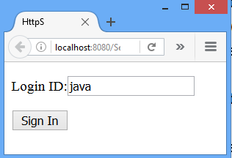
Session Management : HttpSession
Httpsession.html
<html>
<head>
<title>HttpSession</title>
</head>
<body>
<form action="/Session/HSession1" method="Get">
<p>Login ID:<input type="text" name="login"></p>
<p><input type="submit" value="Sign In"></p>
</form>
</body>
</html>

Slide 54
Session Management : HttpSession
HSession1.java
response.setContentType("text/html");
PrintWriter out=response.getWriter();
RequestDispatcher rd;
String login=request.getParameter("login");
if(login.equals("java") )
{ HttpSession hs=request.getSession();
hs.setAttribute("s_id",login);//set HttpSession
out.println("Session Created");
out.print("<a href='HSession2'>Homepage</a>");
}
else
{ out.println("<p><h1>Incorrect Login Id/Password </h1></p>");
rd=request.getRequestDispatcher("/httpsession.html");
rd.include(request, response);}

Slide 55
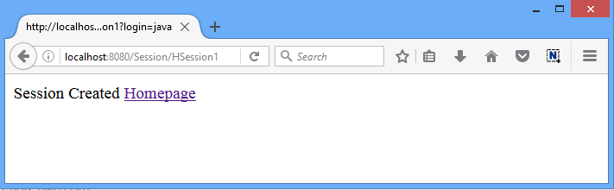
Session Management : HttpSession
Output: HttpSession1.java

Slide 56
Session Management : HttpSession
HSession2.java
public class HSession2 extends HttpServlet
{ public void doGet(HttpServletRequest request, HttpServletResponse response)
throws ServletException,IOException
{response.setContentType("text/html");
PrintWriter out=response.getWriter();
HttpSession hs=request.getSession(false);
String n=(String)hs.getAttribute("s_id");
out.print("Hello "+n);
out.print("<p><a hef='HSession3'>visit</a></p>");
} }

Slide 57
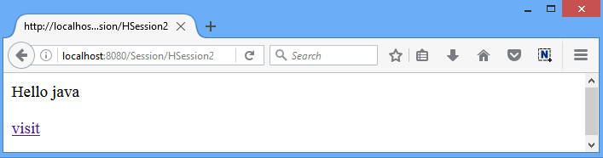
Session Management : HttpSession
Output: HttpSession2.java

Slide 58
Session Management : HttpSession
HSession3.java
public class HSession3 extends HttpServlet
{ public void doGet(HttpServletRequest request, HttpServletResponse response)
throws ServletException,IOException
{response.setContentType("text/html");
PrintWriter out=response.getWriter();
HttpSession hs=request.getSession(false);
String n=(String)hs.getAttribute("s_id");
out.print("Hello again "+n);
out.println("<form action='/Session/HSession4'>");
out.println("<p><input type='submit'
value='End Session'></p></form>");
hs.invalidate();//Session Invalidated
}
}

Slide 59
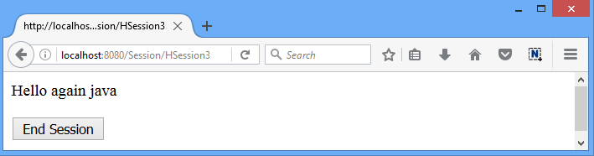
Session Management : HttpSession
Output: HttpSession3.java

Slide 60
Session Management : HttpSession
HSession4.java
public void doGet(HttpServletRequest request, HttpServletResponse response)
throws ServletException,IOExceptio { response.setContentType("text/html");
PrintWriter out=response.getWriter();
HttpSession hs=request.getSession(false);
try
{ String n=(String)hs.getAttribute("s_id");
} catch(NullPointerException ne)
{out.println("Session Invalidated");}
out.println("<form action='/Session/httpsession.html'>");
out.println("<p><input type='submit' value='logout'></p></form>");
}//doGet

Slide 61
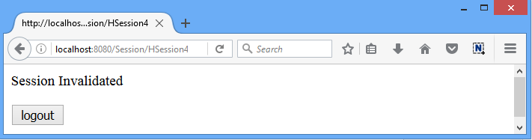
Session Management : HttpSession
Output: HttpSession4.java

Slide 62
Session Timeout

Slide 63
Session Timeout
The session timeout in a web application can be configured in two ways
Timeout in the deployment descriptor (web.xml)
Timeout with setMaxInactiveInterval()

Slide 64
Session Timeout
Timeout in the deployment descriptor (web.xml)
<web-app>
<session-config>
<session-timeout> 10 </session-timeout>
</session-config>
</web-app>
Note that the value of the timeout is set in minutes, not in seconds.
Here specified time is in minutes

Slide 65
Session Timeout
Timeout with setMaxInactiveInterval()
The timeout of the current session only can be specified programmatically via the API of the javax.servlet.http.HttpSession
HttpSession session = request.getSession();
session.setMaxInactiveInterval(10*60);
Here specified time is in seconds

Slide 66
GTU Questions
Write Servlet program to create cookie. Also write code to display contents of cookie on page. [7]
What is session? Explain session management using HTTPSession. [7]
List the different ways to manage the session. [4]

Slide 67
Filter API

Slide 68
Filter API
Web Container
Filter
request
Filter request
Servlet Program
Filter response
response
WebClient

Slide 69
Filter
Filter is used for pre-processing of requests and post-processing of responses.
Filters are configured in the deployment descriptor of a web application.

Slide 70
Filter
Usage of Filter
Recording all incoming requests
Logs the IP addresses of the computers from which the requests originate
Conversion
Data compression
Encryption and Decryption
Input validation etc.

Slide 71
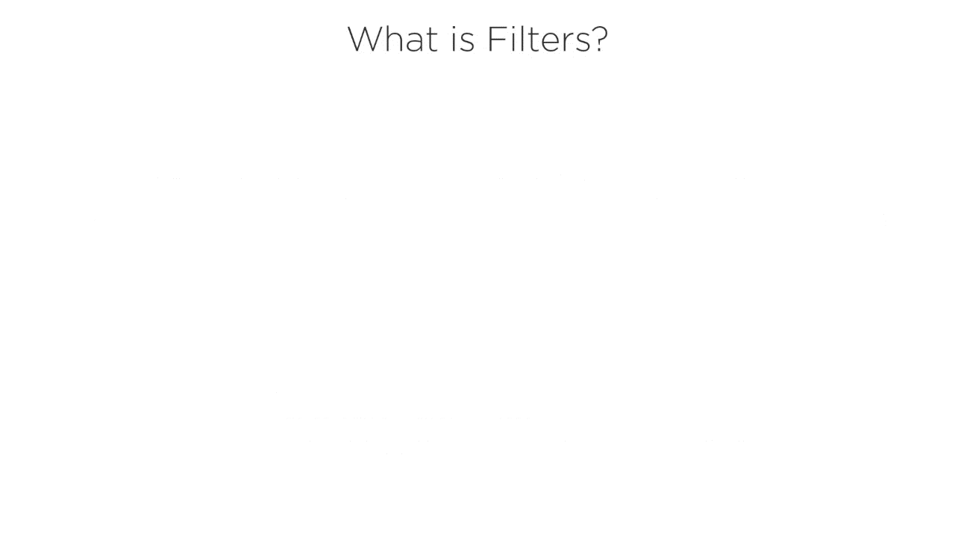
Filter

Slide 72
Filter API
The javax.servlet package contains the three interfaces of Filter API.
Filter
FilterChain
FilterConfig

Slide 73
Filter Interface
For creating any filter, you must implement the Filter interface.
Filter interface provides the life cycle methods for a filter.
Method
void init(FilterConfig config) | init() method is invoked only once. It is used to initialize the filter.
void doFilter (HttpServletRequest request, HttpServletResponse response, FilterChain chain) | doFilter() method is invoked every time when user request to any resource, to which the filter is mapped.It is used to perform filtering tasks.
void destroy() | This is invoked only once when filter is taken out of the service.

Slide 74
Filter Interface
Example
public void init(FilterConfig config)
throws ServletException {…}
public void doFilter(ServletRequest req,
ServletResponse resp,
FilterChain chain)
throws IOException,ServletException
{//filter logic…}
public void destroy() {…}

Slide 75
FilterChain interface
The object of FilterChain is responsible to invoke the next filter or resource in the chain.
This object is passed in the doFilter method of Filter interface.
The FilterChain interface contains only one method:
Example
FilterChain chain;
chain.doFilter(req, resp);//send request to next resource
void doFilter (HttpServletRequest request, HttpServletResponse response) | It passes the control to the next filter or resource.

Slide 76
Filter Config
FilterConfig is created by the web container.
This object can be used to get the configuration information from the web.xml file.
Method
void init(FilterConfig config) | init() method is invoked only once it is used to initialize the filter.
String getInitParameter (String parameterName) | Returns the parameter value for the specified parameter name.

Slide 77
Filter Example
Web Container
Filter1.java
FilteredServlet.java
request
Filter request
Servlet Program
Filter response
response
WebClient

Slide 78
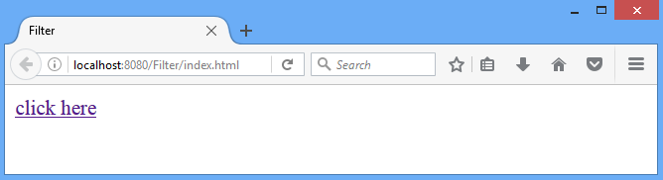
Filter Example: index.html
<html>
<head>
<title>Filter</title>
</head>
<body>
<a href="FilteredServlet">click here</a>
</body>
</html>

Slide 79
Filter Example1
web.xml
<web-app>
<servlet>
<servlet-name>FilteredServlet</servlet-name>
<servlet-class>FilteredServlet</servlet-class>
</servlet>
<servlet-mapping>
<servlet-name>FilteredServlet</servlet-name>
<url-pattern>/FilteredServlet</url-pattern>
</servlet-mapping>

Slide 80
Filter Example1
web.xml
<filter>
<filter-name>f1</filter-name>
<filter-class>Filter1</filter-class>
</filter>
<filter-mapping>
<filter-name>f1</filter-name>
<url-pattern>/FilteredServlet</url-pattern>
</filter-mapping>

Slide 81
Filter Example1: Filter1.java
public class Filter1 implements Filter
{public void init(FilterConfig arg0) throws ServletException {//overridden init() method}
public void doFilter(ServletRequest req,
ServletResponse resp,FilterChain chain) throws IOException, ServletException
{ PrintWriter out=resp.getWriter();
out.print("filter is invoked before");//exe. with request
chain.doFilter(req, resp);//send request to nextresource
out.print("filter is invoked after");//exe. with response
}
public void destroy() {//overridden destroy() method}
}

Slide 82
Filter Example1: FilteredServlet.java
import java.io.IOException;
import java.io.PrintWriter;
import javax.servlet.*;
import javax.servlet.http.*;
public class FilteredServlet extends HttpServlet
{ public void doGet(HttpServletRequest request, HttpServletResponse response)
throws ServletException, IOException
{
response.setContentType("text/html");
PrintWriter out = response.getWriter();
out.println("<br>welcome to servlet<br>");
}
}

Slide 83
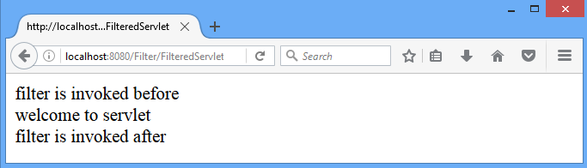
Filter Example1: Output
Filter1.java [executed with request]
FilteredServlet.java [Servlet code]
Filter1.java [executed with response]

Slide 84
Filter Example2
Web Container
Filter1.java
Filter2.java
FilteredServlet.java
Servlet Program
WebClient
Authenticate User
Check config parameter

Slide 85
Filter Example2
index.html
<html>
<head>
<title>filter</title>
</head>
<body>
<form action="/Filter/FilteredServlet" >
<p>Login ID:<input type="text" name="login"></p>
<p>Password:<input type="password" name="pwd"></p>
<p><input type="submit" value="Sign In"></p>
</form>
</body>
</html>

Slide 86
Filter Example2
web.xml
<web-app>
<servlet>
<servlet-name>FilteredServlet</servlet-name>
<servlet-class>FilteredServlet</servlet-class>
</servlet>
<servlet-mapping>
<servlet-name>FilteredServlet</servlet-name>
<url-pattern>/FilteredServlet</url-pattern>
</servlet-mapping>

Slide 87
Filter Example2
web.xml
<filter>
<filter-name>f1</filter-name>
<filter-class>Filter1</filter-class>
</filter>
<filter-mapping>
<filter-name>f1</filter-name>
<url-pattern>/FilteredServlet</url-pattern>
</filter-mapping>

Slide 88
Filter Example2
web.xml
<filter>
<filter-name>f2</filter-name>
<filter-class>Filter2</filter-class>
<init-param>
<param-name>permit</param-name>
<param-value>yes</param-value>
</init-param>
</filter>
<filter-mapping>
<filter-name>f2</filter-name>
<url-pattern>/FilteredServlet</url-pattern>
</filter-mapping>
</web-app>

Slide 89
Filter Example2
Filter1.java
public class Filter1 implements Filter{
public void init(FilterConfig config) {}
public void doFilter(ServletRequest req,
ServletResponse resp, FilterChain chain)
throws IOException, ServletException
{ PrintWriter out=resp.getWriter();
out.print("<p>filter1 is invoked before</p>");
if(req.getParameter("login").equals("java") &&
req.getParameter("pwd").equals("servlet"))
{ chain.doFilter(req, resp);//send request to next resource
}//if
else
{out.print("<p>invalid login/password</p>");}//else
out.print("<p>filter1 is invoked after</p>");
}
public void destroy() {}}

Slide 90
Filter Example2
Filter2.java
public class Filter2 implements Filter{
String permission;
public void init(FilterConfig config) throws ServletException
{ permission=config.getInitParameter("permit"); }
public void doFilter(ServletRequest req, ServletResponse resp,
FilterChain chain) throws IOException, ServletException
{ PrintWriter out=resp.getWriter();
out.print("<p>filter2 is invoked before</p>");
if(permission.equals("yes"))
{ chain.doFilter(req, resp);}//if
else
{ out.println("Permission Denied"); }//else
out.print("<p>filter2 is invoked after</p>"); }
public void destroy() {}}

Slide 91
Filter Example2
FilteredServlet.java
public class FilteredServlet extends HttpServlet {
public void doGet(HttpServletRequest request, HttpServletResponse response)
throws ServletException, IOException
{
response.setContentType("text/html");
PrintWriter out = response.getWriter();
out.println("<p><h3>welcome to servlet</h3></p>");
}
}

Slide 92
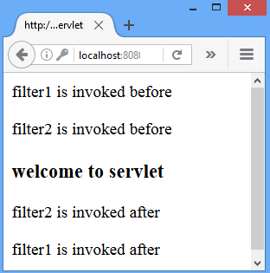
Filter Example2:output

Slide 93
Filter
Advantage of Filter
Filter is pluggable.
One filter don't have dependency onto another resource.
Less Maintenance Cost
The servlet filter is pluggable, i.e. its entry is defined in the web.xml file, if we remove the entry of filter from the web.xml file, filter will be removed automatically and we don't need to change the servlet.
So maintenance cost will be less.

Slide 94
GTU Questions:Filter
1. | What is Filter? List the applications of filter. [3] | Win’17 Win’18
2. | Explain the configuration of filter using deployment descriptor.[4] | Sum’18

Slide 95
Attributes in Servlet

Slide 96
Attributes in Servlet
SetAttributeDemo.java
ServletContext context=getServletContext();
context.setAttribute("college", "diet");
out.println("<a href='/New/GetAttributeDemo'>next</a>");
GetAttributeDemo.java
ServletContext context=getServletContext();
String value=(String)context.getAttribute("college");
out.println("Welcome "+value);

Slide 97
Servlet with JDBC

Slide 98
Servlet with JDBC
import java.io.*;
import java.sql.*;
import javax.servlet.*;
import javax.servlet.http.*;
public class JDBCServlet extends HttpServlet
{
public void doGet(HttpServletRequest request, HttpServletResponse response)
throws ServletException,IOException
{ response.setContentType("text/html");
PrintWriter out=response.getWriter();
//Program continued in next slide…
...

Slide 99
Servlet with JDBC
try{
Class.forName("com.mysql.jdbc.Driver");
Connection con=DriverManager.getConnection ("jdbc:mysql://localhost:3306/ajava","root","");
Statement st=con.createStatement();
ResultSet rs=st.executeQuery("select * from cxcy");
while(rs.next())
{ out.println("<p>"+rs.getInt(1));
out.println(rs.getString(2));
out.println(rs.getString(3)+"</p>");
}
}catch(Exception e)
{out.println("<p>inside exception"+e.toString()+"</p>");}
}//doGet()
}//Class

Slide 100
Types of Servlet Events
Events are basically occurrence of something.
Changing the state of an object is known as an event.
There are many Event classes and Listener interfaces in the javax.servlet and javax.servlet.http packages.
In web application world an event can be
Initialization of application
Destroying an application
Request from client
Creating/destroying a session
Attribute modification in session etc.

Slide 101
Types of Servlet Events
Event classes
ServletRequestEvent | Events of this kind indicate lifecycle events for a ServletRequest. The source of the event is the ServletContext of this web application.
ServletContextEvent | This is the event class for notifications about changes to the servlet context of a web application.
ServletRequestAttributeEvent | This is the event class for notifications of changes to the attributes of the servlet request in an application.
ServletContextAttributeEvent | Event class for notifications about changes to the attributes of the ServletContext of a web application.
HttpSessionEvent | This is the class representing event notifications for changes to sessions within a web application.
HttpSessionBindingEvent | Send to an Object that implements HttpSessionBindingListener when bound into a session or unbound from a session.

Slide 102
GTU Servlet Programs
1. | Write a Java Servlet to demonstrate the use of Session Management. | [Win’18] [Sum’18] [Win’16] [Win’15]
2. | Write small web application which takes marks of three subject and pass to servlet. Servlet forward to model class having method getClass() and getPercentage(). Display class and percentage | [Sum’16]
3. | Write servlet which displayed following information of client. I. Client Browser II. Client IP address III. Client Port No IV. Server Port No. V. Local Port No VI. Method used by client for form submission VII. Query String name and values | [Sum’16]
4. | Write a Java Servlet to print BE Semester 7 Marksheet of entered enrollment number by user using JDBC. | [Sum’18] [Sum’15] [Sum’19]
5. | Write a servlet which accept two numbers using POST methods and display the maximum of them. | [Win’14]

Slide 103
GTU Servlet Programs
7.
6. | Write a web application using servlet to compute an area of a circle. Get the radius from the client. Write necessary web.xml file. | [Win’13]

Slide 104
GTU Servlet Theory Questions
1. | Explain Servlet Life Cycle with example to demonstrate every state. Explain role of web container. Explain importance of context object. | [Sum’17] [Win’18] [Win’19] [Sum’19]
2. | What is filter? What is its use? List different filter interfaces with their important methods. Explain the configuration of filter using deployment descriptor. | [Win’18] [Sum’18] [Win’16] [Sum’15]
3. | What is Request Dispatcher? What is the difference between Request dispatcher’s forward() and include() method? | [Win’16]
4. | Explain difference between ServletConfig and ServletContext object. | [Sum’18] [Sum’17] [Win ’19]
5. | Write Servlet program to create cookie. Also write code to display contents of cookie on page. Explain functionality of Cookie.[7] | [Sum’18] [Sum’19]
6. | Write difference between (1) Generic Servlet and Http Servlet (2) doGet and doPost | [Sum’19]

Slide 105
GTU Servlet Theory Questions
7. | What is session? Explain session management using HTTPSession. | [Win’17] [Sum’18] [Win’19] [Sum’19]

Slide 106
Servlet Interview Questions
1. | Who is responsible to create the object of servlet?
2. | What is difference between Get and Post method?
3. | When servlet object is created?
4. | What is difference between PrintWriter and ServletOutputStream?
5. | What is difference between GenericServlet and HttpServlet?
6. | Can you call a jsp from the servlet?
7. | Difference between forward() method and sendRedirect() method ?
8. | What is difference between ServletConfig and ServletContext?
9. | What happens if you add a main method to servlet?
10. | What is MIME Type?
11. | Why main() is not written in servlets programs?
12. | How does the JVM execute a servlet compared with a regular Java class?
13. | Consider a scenario in which 4 users are accessing a servlet instance. Among which one user called destroy() method. What happens to the rest 3 users?
14. | What is Connection Pooling?
Notes:
web container
3. At the time of first request.
4. PrintWriter is a character-stream class where as ServletOutputStream is a byte-stream class.
6. Yes, one of the way is RequestDispatcher interface for example:
9. Cookie works at client side whereas HttpSession works at server side.
10. MIME stands for Multipurpose Internet Mail Extensions. It's a way of identifying files on the Internet according to their nature and format.
text/css

Slide 107
Servlet Interview Questions
15. | Servlet is Java class. Then why there is no constructor in Servlet? Can we write the constructor in Servlet? Justify your answer.

